Slide 1
Lecture 13: Validation and Evaluation
DS 4200
Fall 2022
Prof. Ab Mosca (they/them)
Northeastern University
Slides and inspiration from Cody Dunne, Michelle Borkin, Remco Chang, Dylan Cashman, Krzysztof Gajos, Hanspeter Pfister,
Miriah Meyer, Jonathan Schwabish, and David Sprague

Slide 2
Last Class
We:
Reviewed Filtering and Aggregation
Reviewed Focus+Context Designs
Any Questions?

Slide 3
Note on Schedule
Upcoming schedule:
https://amosca01.github.io/DS4200-F22/#schedule
tl;dr
Next pm is short and due EOD Wednesday. The following pm is longer and due in 10 days instead of a week.
This avoids having an assignment due on a holiday.

Slide 4
Validation and Evaluation

Slide 5
Why Evaluate and Validate?
Based off what you know about the visualization design process, why would we need to evaluate and validate our visualization designs?
Validation

Slide 6
Why Evaluate and Validate?
Do my target users understand how to use the visualization?
Does this support the task(s) I intended to support?
Are there extra features that get in the way?
Are there missing features I need to add?
Did I pick an effective visual encoding?
Are the interactions responsive enough?
Based off what you know about the visualization design process, why would we need to evaluate and validate our visualization designs?
Validation

Slide 7
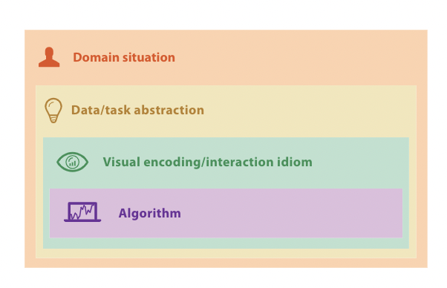
Munzner’s Nested Model
Do my target users understand how to use the visualization?
Does this support the task(s) I intended to support?
Are there extra features that get in the way?
Are there missing features I need to add?
Did I pick an effective visual encoding?
Are the interactions responsive enough?
Validation
Notes:
One of the benefits of looking at the visualization design process in these segments, is that it can also guide our evaluations of visualization tools

Slide 8
Munzner’s Nested Model
Threats to validity exist at each stage of visualization design
Validation
Notes:
When Tamara developed this Nested Model, she identified potential issues that could arise at every step of the design process.
She calls these potential issues “threats to validity” of the visualization design.
Here are some specific examples <read>

Slide 9
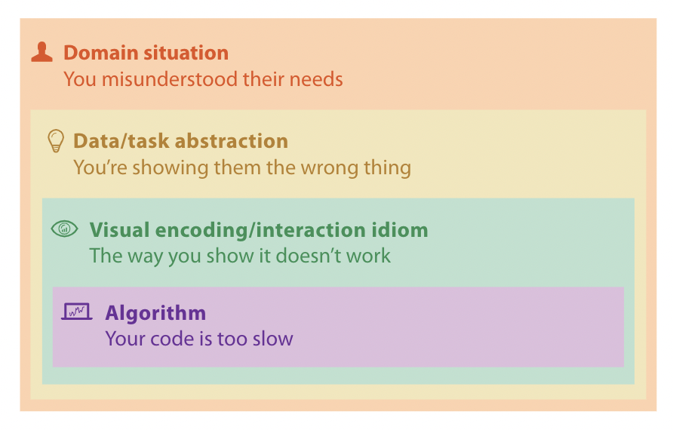
Munzner’s Nested Model
Threats to validity exist at each stage of visualization design
Validation
Notes:
When Tamara developed this Nested Model, she identified potential issues that could arise at every step of the design process.
She calls these potential issues “threats to validity” of the visualization design.
Here are some specific examples <read>

Slide 10
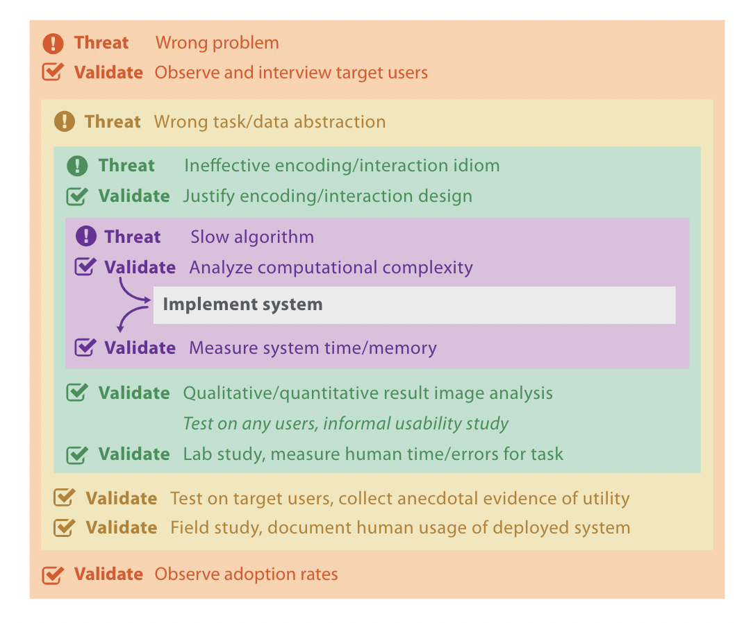
Munzner’s Nested Model
Threats to validity exist at each stage of visualization design
Validate every step using appropriate technique
Validation
Notes:
In addition to highlighting potential issues at each step in the design process, Munzner explains how we can isolate and test validity at individual steps.
<don’t read yet>
Because the goal or purpose of each step is unique, there are different evaluation and validation techniques that are appropriate at each level.
Let’s look more in detail at some examples.
<next>

Slide 11
Munzner’s Nested Model
Threats to validity exist at each stage of visualization design
Validate every step using appropriate technique
Domain situation
Typically use qualitative evaluation techniques
Ex. Ethnographic field studies, semi-structured interviews
Validation
Notes:
Our first, or outermost step in the nested model for visualization design is identifying and understanding a domain problem.
Typically, the methods we use to evaluate whether or not we correctly understood a domain problem are qualitative (as opposed to quantitative).
Qualitative approaches include things like ethnographic field studies, where you would look at adoption rates and use of your visualization tool “in the wild”,
or semi-structured interviews, where you ask targeted questions about usefulness of your visualization tool in a controlled setting such as on a video call in person or through a survey.

Slide 12
Munzner’s Nested Model
Threats to validity exist at each stage of visualization design
Validate every step using appropriate technique
Data / task abstraction
Typically use qualitative evaluation techniques
Ex. Short or long term observational studies
Validation
Notes:
The second,step in the nested model for visualization design is data/task abstraction.
We also typically use qualitative methods to evaluate whether we correctly abstracted tasks and data for a visualization tool.
Often the qualitative approach used here is something called an observational study, the structure of which we’ll discuss in detail later in this lecture.

Slide 13
Munzner’s Nested Model
Threats to validity exist at each stage of visualization design
Validate every step using appropriate technique
Visual encoding / interaction
Can use qualitative or quantitative evaluation techniques
Ex. Informal usability study, formal lab study
Validation
Notes:
The third nested step in the nested model for visualization design is the visual encoding and interaction idiom.
To test validity at this level qualitative or quantitative methods can be used.
Typically evaluations at this level include informal usability studies (which are qualitative in nature), or formal lab studies that are quantitative in nature. In other words, they collect specific metrics that are analyzed through statistical analyses. We will talk in more detail about both of these approaches later in this lecture.

Slide 14
Munzner’s Nested Model
Threats to validity exist at each stage of visualization design
Validate every step using appropriate technique
Algorithm
Quantitative evaluation
Analyze computational complexity
Validation
Notes:
The final fourth step in the nested model for visualization design is algorithm design and implementation.
Typically evaluations of this step are quantitative, and include methods like analyzing computational complexity or measuring time and memory usage of the implemented algorithm.

Slide 15
Evaluation Methods
Theoretical / Simulation Based
→ Inspection or Principled Rationale
→ Theoretical Analysis
→ Benchmarks
Human Subject Experiments
Controlled Experiment
Observational Study
→ Field Deployment or Case Studies
Validation
Notes:
There are two major categories of evaluation methods: theoretical and simulation based evaluations, and human subject experiments.
The main differentiation between these two is whether people (i.e. users) are involved in the experiments.

Slide 16
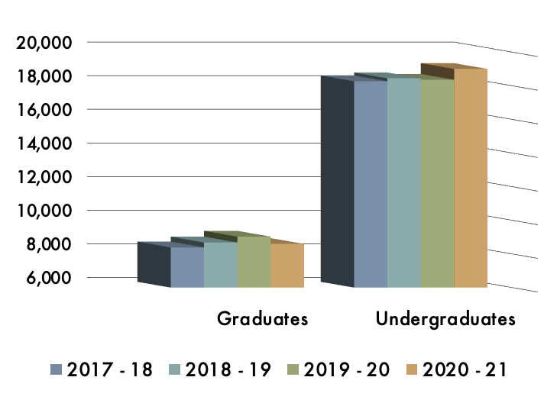
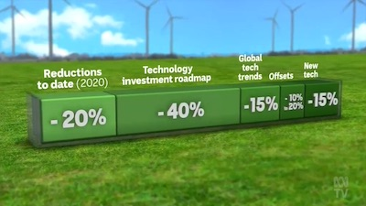
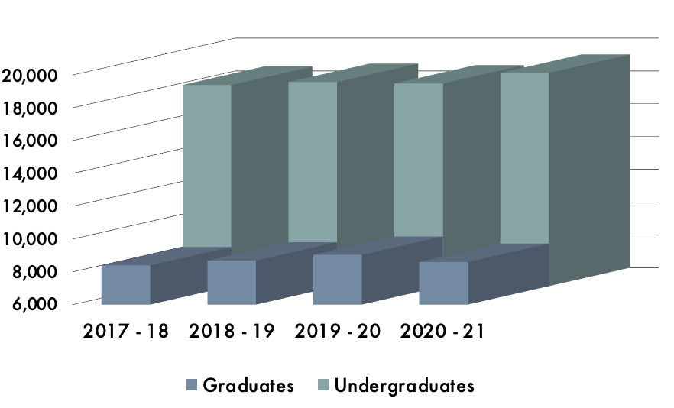
Evaluation Methods
Theoretical / Simulation Based
Inspection or Principled Rationale
→ Apply design heuristics, perceptual principles
Validation
https://www.vislies.org/2021/gallery/
Notes:
Let’s start by looking at Theoretical/simulation based evaluations.
The first category under this umbrella is inspection or principle based rationale. This amounts to analyzing visualizations by examining how well they adhere to things like design heuristics (ex. The design rules of thumb we talked about earlier), or perceptual principles (ex. Gestalt principles, color perception).
The second category under this umbrella is theoretical analysis. This refers to things like analyzing algorithm time and space complexities. In other words how long will this algorithm take to run and how much space does it need.
The final category under this umbrella is benchmarks. This method evaluates a visualization by comparing it’s performance to well known benchmarks in different areas. For example comparing the interactive frame rate of your visualization to the industry standard, or looking at how well your visualization would scale for larger datasets.

Slide 17
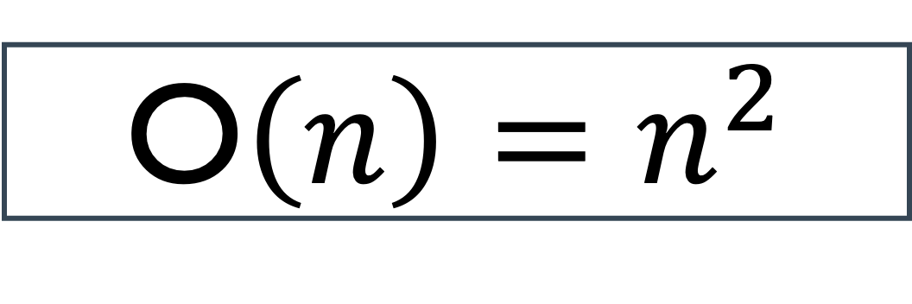
Evaluation Methods
Theoretical / Simulation Based
Theoretical Analysis
→ Algorithm time and space complexity
Validation
O$\left(n\right)=n^{2}$
Notes:
Let’s start by looking at Theoretical/simulation based evaluations.
The first category under this umbrella is inspection or principle based rationale. This amounts to analyzing visualizations by examining how well they adhere to things like design heuristics (ex. The design rules of thumb we talked about earlier), or perceptual principles (ex. Gestalt principles, color perception).
The second category under this umbrella is theoretical analysis. This refers to things like analyzing algorithm time and space complexities. In other words how long will this algorithm take to run and how much space does it need.
The final category under this umbrella is benchmarks. This method evaluates a visualization by comparing it’s performance to well known benchmarks in different areas. For example comparing the interactive frame rate of your visualization to the industry standard, or looking at how well your visualization would scale for larger datasets.

Slide 18
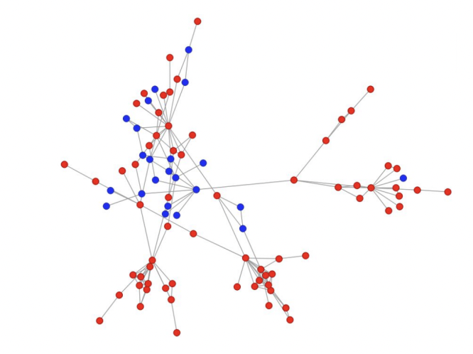
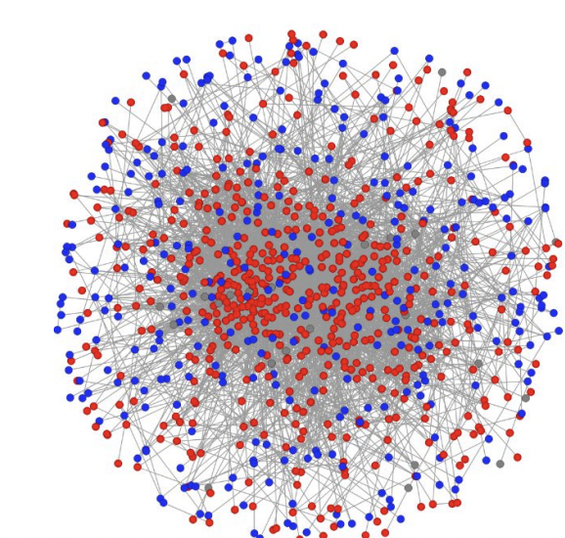
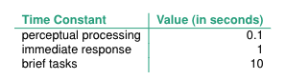
Evaluation Methods
Theoretical / Simulation Based
Benchmarks
→ Scalability to larger data sets
→ Performance (e.g., interactive
frame rates)
Validation
https://www.cs.ubc.ca/~tmm/courses/547-19/slides/javier-persisthomol.pdf
Notes:
Let’s start by looking at Theoretical/simulation based evaluations.
The first category under this umbrella is inspection or principle based rationale. This amounts to analyzing visualizations by examining how well they adhere to things like design heuristics (ex. The design rules of thumb we talked about earlier), or perceptual principles (ex. Gestalt principles, color perception).
The second category under this umbrella is theoretical analysis. This refers to things like analyzing algorithm time and space complexities. In other words how long will this algorithm take to run and how much space does it need.
The final category under this umbrella is benchmarks. This method evaluates a visualization by comparing it’s performance to well known benchmarks in different areas. For example comparing the interactive frame rate of your visualization to the industry standard, or looking at how well your visualization would scale for larger datasets.

Slide 19
Evaluation Methods
Human Subject Experiments
Controlled Experiments
Observational Studies
Field Deployment or Case Studies
Notes:
The other major category of evaluation methods is human subject experiments.
This includes <read>
<next>

Slide 20



Evaluation Methods
Human Subject Experiments
Controlled Experiments
Observational Studies
Field Deployment or Case Studies
Notes:
Something I want to highlight here is that when you’re deciding how to design these human-subject experiments, deciding who you will use as participants is often a very important part of the process, and it’s going to be largely influenced by your evaluation goal.
For example, if you’re trying to evaluate how well a visualization solves a domain problem, you should probably run that experiment with domain experts as your users.
In contrast, of you’re trying to see if the interactions embedded in your visualization are intuitive, then a group of diverse participants from any background is probably a good choice.
Let’s look at each type of human subject evaluation in detail.

Slide 21

Evaluation Methods
A
New Vis
B
Comparison Vis 1
C
Comparison Vis 2
Human Subject Experiments
Controlled Experiment
→ Specific repeated task across multiple conditions
→ Collect quantitative data (ex. time, accuracy)
Task: Find all outliers in the data
Collect: Time, Accuracy
Compare data across groups
Notes:
First, controlled experiments.
These are experiments where a specific task or set of tasks are repeated across multiple conditions, and quantitative data such as time and accuracy is collected and used to compare performance across conditions.
For example, say I was designing a controlled experiment to compare vis A, a new vis I developed to Vis B and C, existing visualizations.
Let’s say I want to compare how well each visualization supports identification of outliers.
To test this with a controlled experiment, I would need one dataset that I can use in each visualization, and a set of participants (or human subjects).
Because I’m interested in how well the visualizations support outlier detection, I would assign my participants the task of identifying outliers in the data. While they did this I would record performance metrics, that I can later use to quantitatively compare performance across the three visualizations. Let’s say for this example that I collect time and accuracy on the outlier detection task.
To compare my three visualization, I would compare average time and accuracy on the outlier detection task with each visualization and look for differences. This would be done using statistical analysis.

Slide 22
Evaluation Methods
A
New Vis
B
Comparison Vis 1
C
Comparison Vis 2
Human Subject Experiments
Controlled Experiment
→ Specific repeated task across multiple conditions
→ Collect quantitative data (ex. time, accuracy)
→ There are many ways to design a controlled experiment (i.e. many experimental designs). We’ll touch on some more later.
Task: Find all outliers in the data
Collect: Time, Accuracy
Compare data across groups
Notes:
One things I want to highlight here, is that there are many ways to design controlled experiments. We’ll come back to discussing design options later
For now, what I want you to know is that controlled experiments rely on a specific repeated task across multiple conditions, and they collect quantitative data as a performance metric.

Slide 23
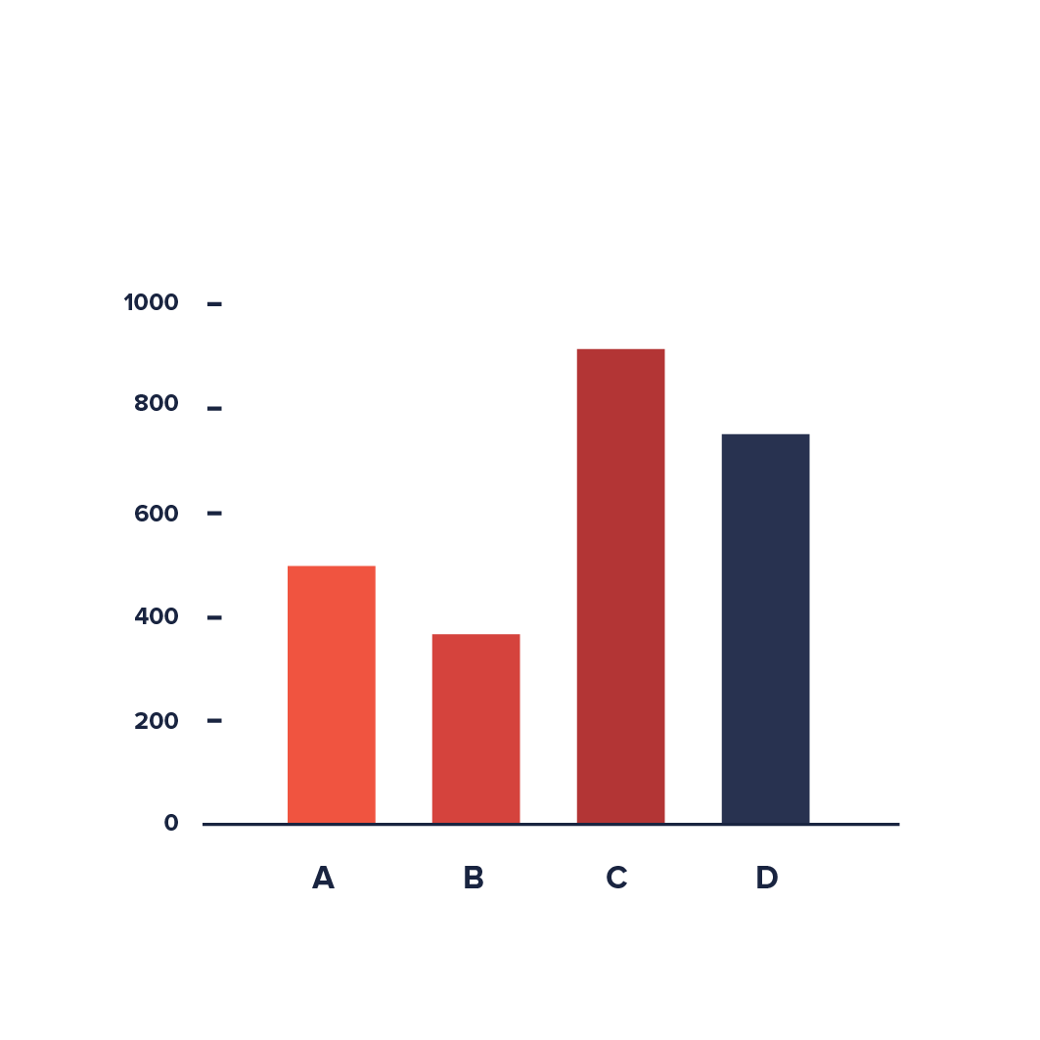
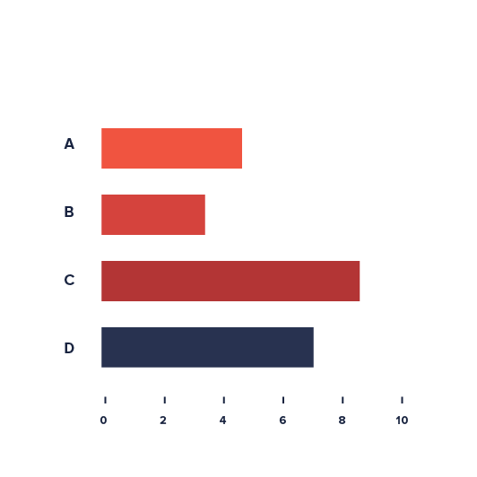
Evaluation Methods
Human Subject Experiments
Controlled Experiment
→ Specific repeated task across multiple conditions
→ Collect quantitative data (ex. time, accuracy)
A
B
Task: ?
Collect: ?
Compare data across groups
https://datavizproject.com/
Notes:
One things I want to highlight here, is that there are many ways to design controlled experiments. We’ll come back to discussing design options later
For now, what I want you to know is that controlled experiments rely on a specific repeated task across multiple conditions, and they collect quantitative data as a performance metric.

Slide 24
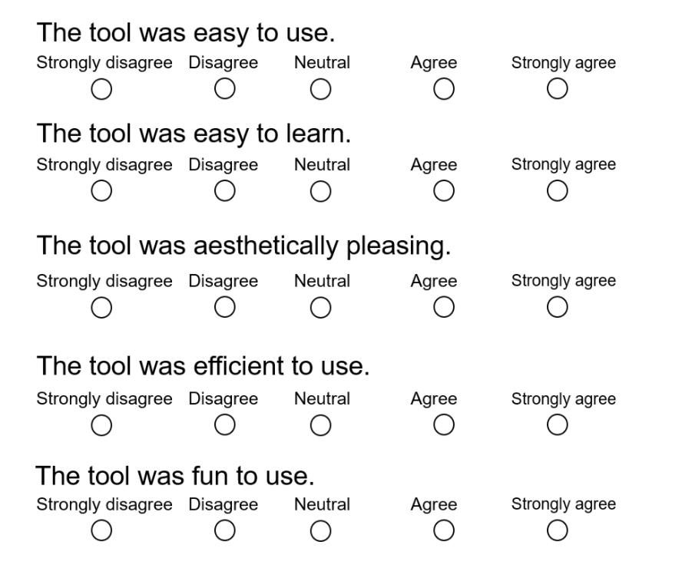

Evaluation Methods
A
New Vis
B
Comparison Vis 1
C
Comparison Vis 2
Human Subject Experiments
Observational Study
→ Specific repeated task across multiple conditions (or not)
→ Collect qualitative data (ex. user findings, think-out-loud data, satisfaction) and quantitative
Validation
Task: Find all outliers in the data
Collect: Think out loud, Likert scales
Compare data across groups
Code data & compare themes
Compare # insights
Compare Likert scale evaluations on satisfaction and ease of use
https://neu.co1.qualtrics.com/jfe/form/SV_8kbi3XRZ628CoPH
Notes:
The next type of human-subject experiment we’ll talk about are observational studies.
Similar to controlled experiments, these experiments typically require a specific task or set of tasks are repeated across multiple conditions. Unlike controlled experiments, the performance metric collected for observational studies is typically qualitative. For example, user findings, recordings of user’s thinking out loud as they perform an analysis, user satisfaction and confidence ratings, etc.
Let’s walk through an example of an observational study set-up.
Say I still want to compare vis A, a new vis I developed to Vis B and C, existing visualizations just like in the previous example.
I’ll still use the same dataset and outlier detection task across visualizations, but this time instead of collecting my participants’ time and accuracy as they complete the outlier detection task I’m going to ask them to narrate their usage of the visualization tool, and to fill out a few likert scales for satisfaction and confidence after using the tool.
To analyze this qualitative data I would need to go through a process called coding, where I identify common themes in the recorded narrations, or identify the number of insights each participant found. Then I could use statistical analyses to compare outcomes from my coded data across visualization tools, and to compare likert scale reportings.

Slide 25
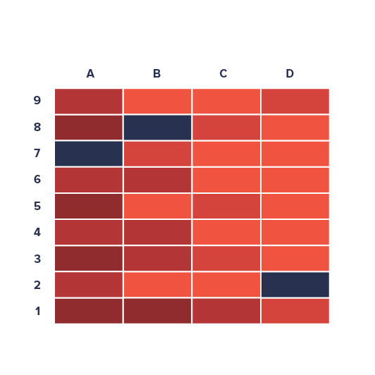
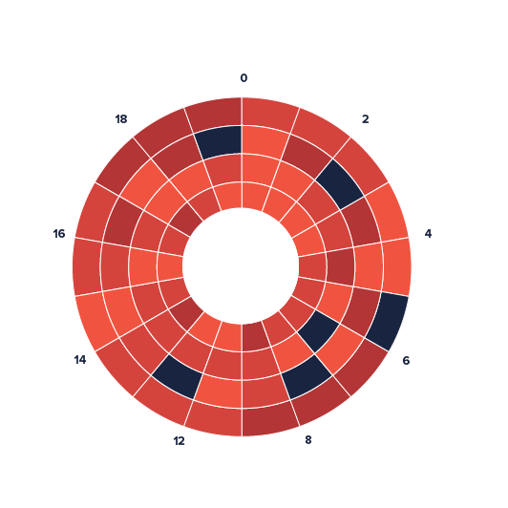
Evaluation Methods
Human Subject Experiments
Observational Study
→ Specific repeated task across multiple conditions (or not)
→ Collect qualitative data (ex. user findings, think-out-loud data, satisfaction) and quantitative
A
B
Validation
Task: ?
Collect: ?
Compare data across groups
https://datavizproject.com/
Notes:
The next type of human-subject experiment we’ll talk about are observational studies.
Similar to controlled experiments, these experiments typically require a specific task or set of tasks are repeated across multiple conditions. Unlike controlled experiments, the performance metric collected for observational studies is typically qualitative. For example, user findings, recordings of user’s thinking out loud as they perform an analysis, user satisfaction and confidence ratings, etc.
Let’s walk through an example of an observational study set-up.
Say I still want to compare vis A, a new vis I developed to Vis B and C, existing visualizations just like in the previous example.
I’ll still use the same dataset and outlier detection task across visualizations, but this time instead of collecting my participants’ time and accuracy as they complete the outlier detection task I’m going to ask them to narrate their usage of the visualization tool, and to fill out a few likert scales for satisfaction and confidence after using the tool.
To analyze this qualitative data I would need to go through a process called coding, where I identify common themes in the recorded narrations, or identify the number of insights each participant found. Then I could use statistical analyses to compare outcomes from my coded data across visualization tools, and to compare likert scale reportings.

Slide 26
Evaluation Methods
Human Subject Experiments
Observational Study
Usability Studies
→ Observational study specifically focused on usability of a visualization
→ Range from low to high fidelity testing
Notes:
Another type of observational study I want to touch on today is usability studies.
These are observational studies geared strictly towards evaluating a usability of a tool.
These types of studies can be formal observational studies that follow the structure I just explained, but with tasks and analyses the focus specifically on usability (for example checking narrations for recurring cases of participants being unable to find a particular button, or confused by some interactive functionality).
Or they can be something called low-fidelity tests. Low fidelity tests are used to test usability of a tool during the early design phases, as opposed to after the tool has been built in it’s entirely.
Often this is done with low-fidelity prototypes that are either made of paper (as shown here), or with wireframes which I’ll show you an example of in a moment.
In either case the set up of these studies consist of having participants perform a specific repeated task and narrating their completion of said task using a prototype of the final tool.
This can help illuminate usability issues before going through the trouble of building the entire tool. For example, these kinds of test can illuminate is a particular button is not in an intuitive spot, or if users don’t know where they should look to find some functionality, etc.

Slide 27
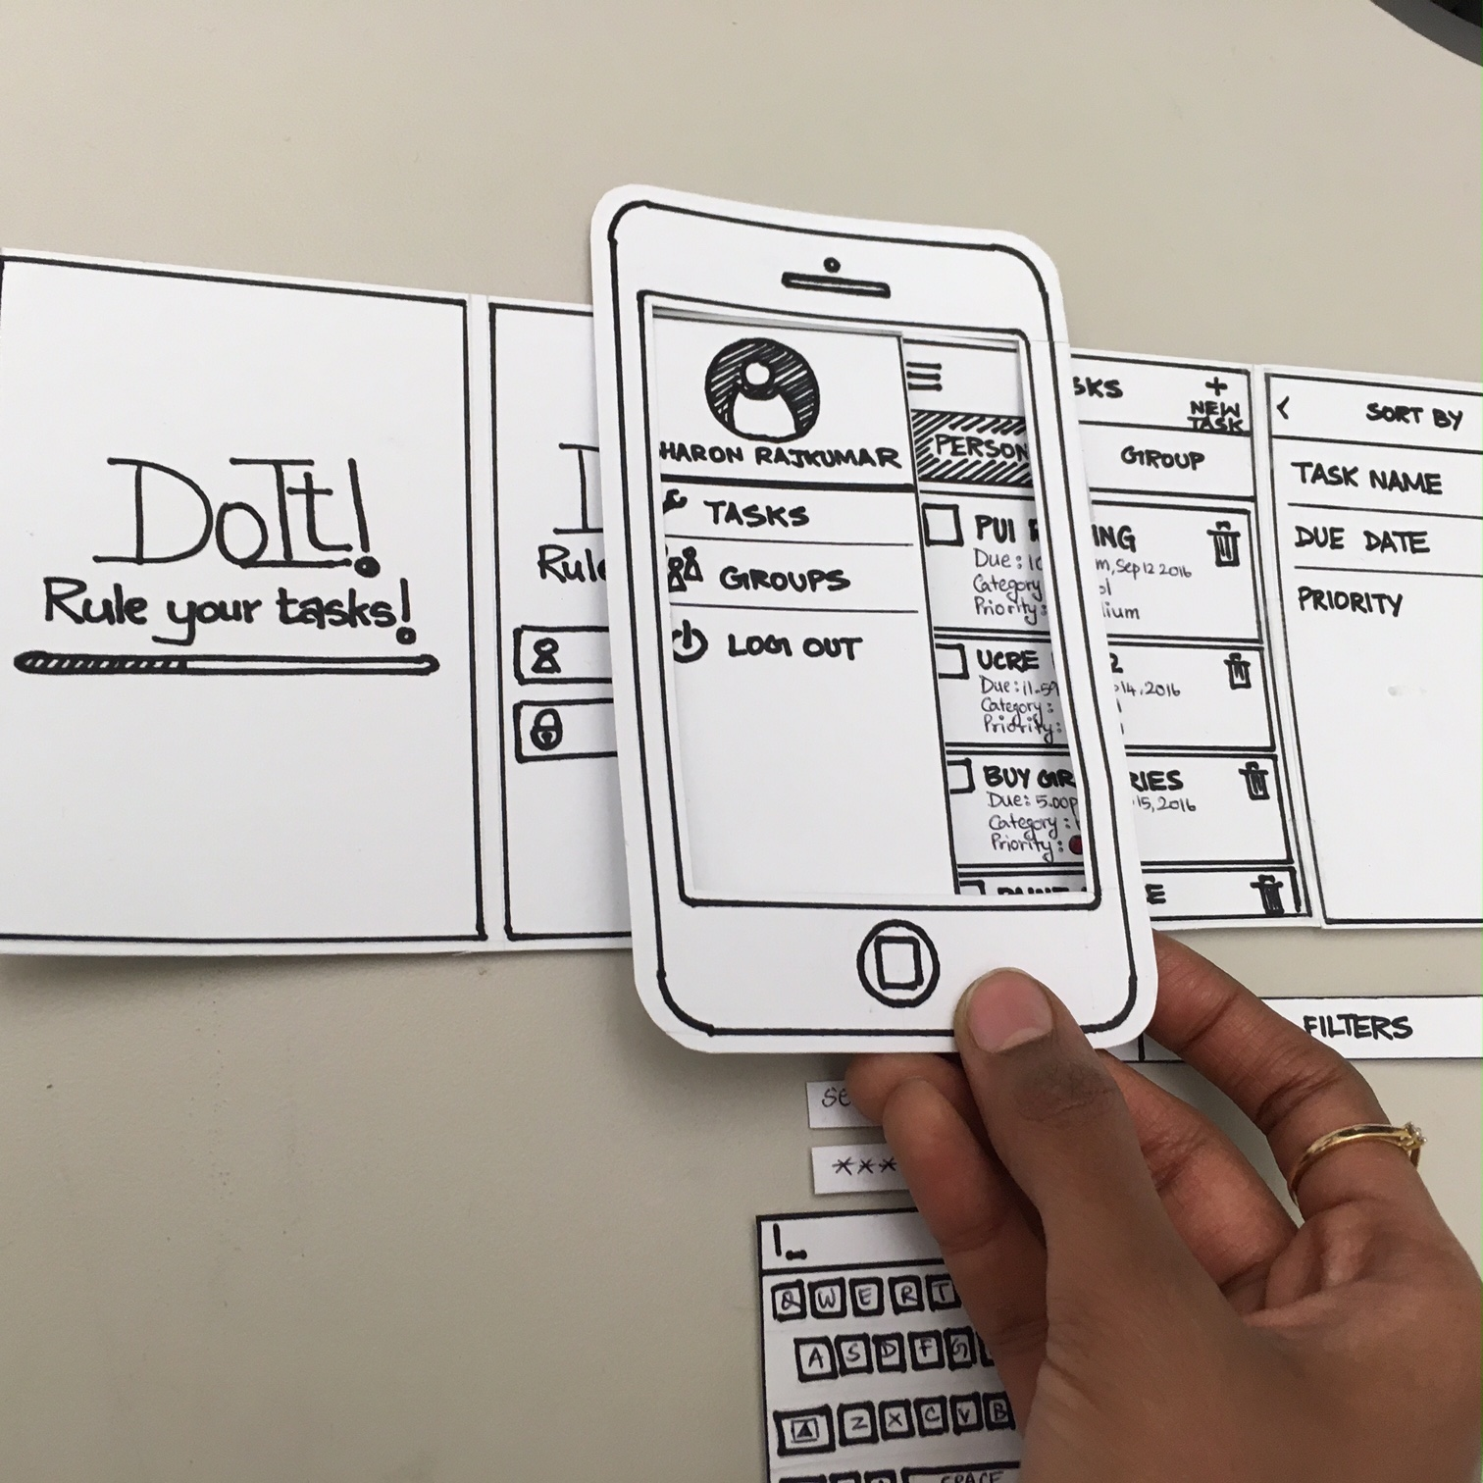
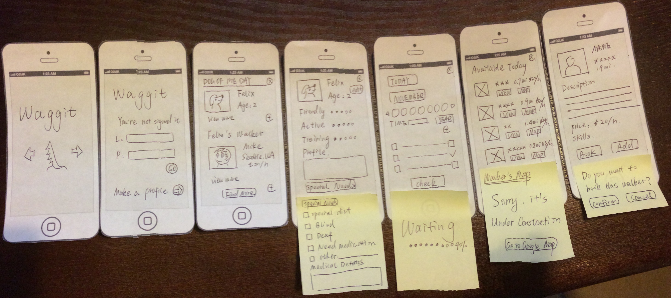
Evaluation Methods
Human Subject Experiments
Observational Study
Usability Studies
→ Observational study specifically focused on usability of a visualization
→ Range from low to high fidelity testing
Low Fidelity
→ Paper prototype
Notes:
Another type of observational study I want to touch on today is usability studies.
These are observational studies geared strictly towards evaluating a usability of a tool.
These types of studies can be formal observational studies that follow the structure I just explained, but with tasks and analyses the focus specifically on usability (for example checking narrations for recurring cases of participants being unable to find a particular button, or confused by some interactive functionality).
Or they can be something called low-fidelity tests. Low fidelity tests are used to test usability of a tool during the early design phases, as opposed to after the tool has been built in it’s entirely.
Often this is done with low-fidelity prototypes that are either made of paper (as shown here), or with wireframes which I’ll show you an example of in a moment.
In either case the set up of these studies consist of having participants perform a specific repeated task and narrating their completion of said task using a prototype of the final tool.
This can help illuminate usability issues before going through the trouble of building the entire tool. For example, these kinds of test can illuminate is a particular button is not in an intuitive spot, or if users don’t know where they should look to find some functionality, etc.

Slide 28
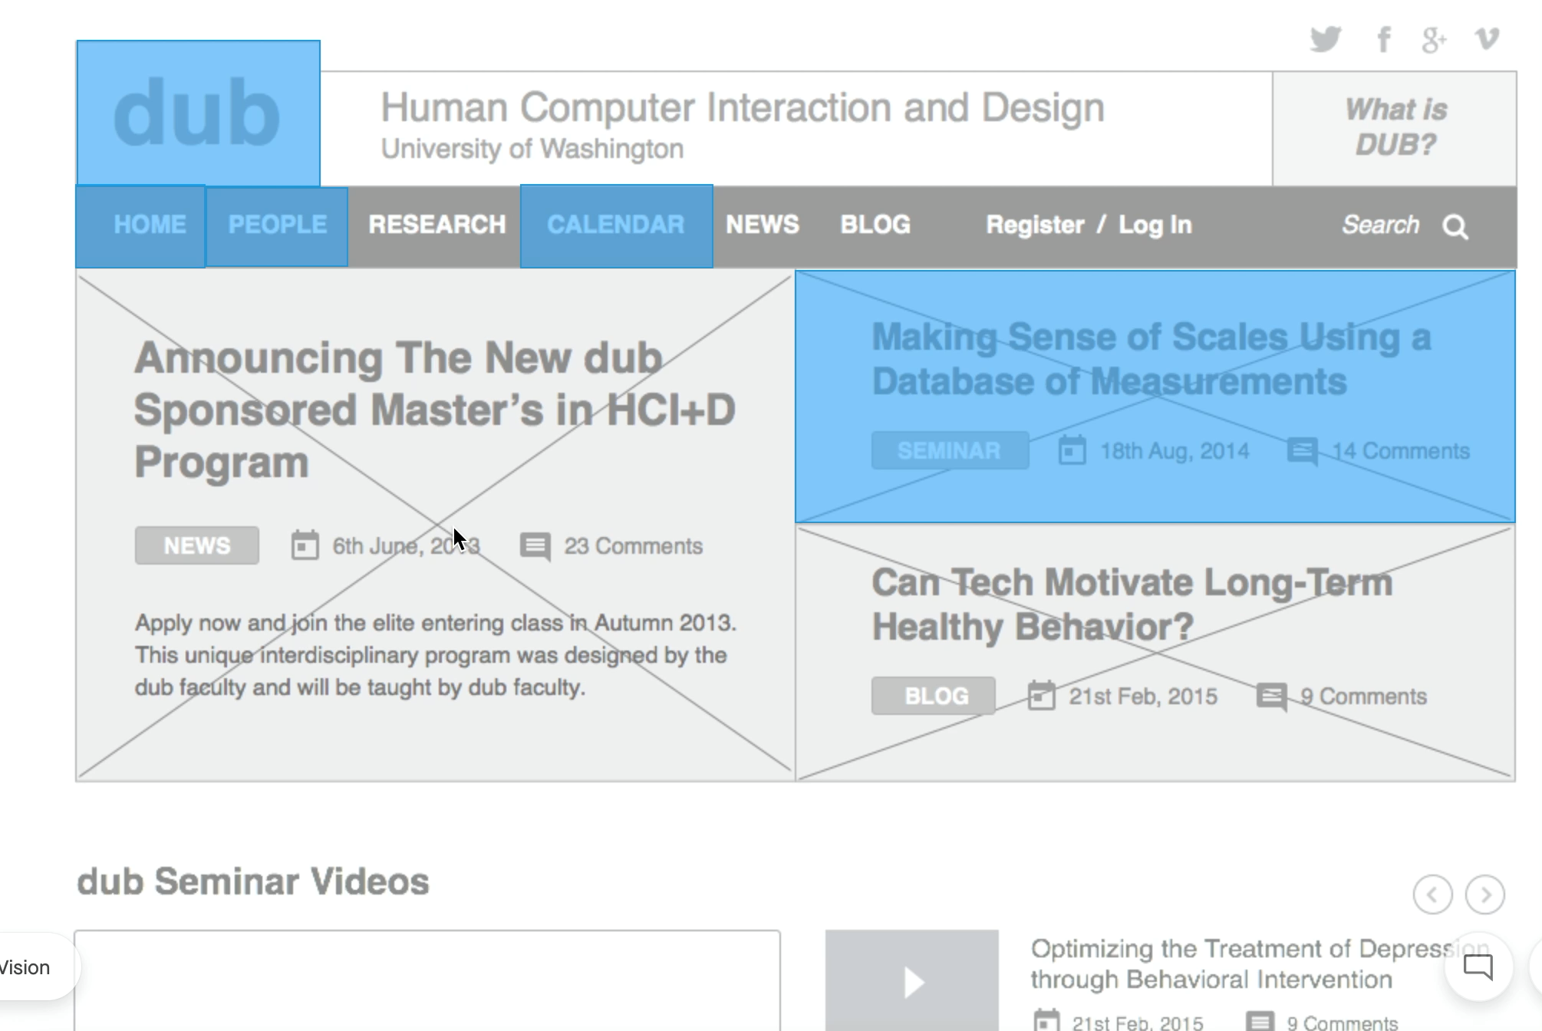
Evaluation Methods
Human Subject Experiments
Observational Study
Usability Studies
→ Observational study specifically focused on usability of a visualization
→ Range from low to high fidelity testing
Medium Fidelity
→ Wireframe
Notes:
Another type of observational study I want to touch on today is usability studies.
These are observational studies geared strictly towards evaluating a usability of a tool.
These types of studies can be formal observational studies that follow the structure I just explained, but with tasks and analyses the focus specifically on usability (for example checking narrations for recurring cases of participants being unable to find a particular button, or confused by some interactive functionality).
Or they can be something called low-fidelity tests. Low fidelity tests are used to test usability of a tool during the early design phases, as opposed to after the tool has been built in it’s entirely.
Often this is done with low-fidelity prototypes that are either made of paper (as shown here), or with wireframes which I’ll show you an example of in a moment.
In either case the set up of these studies consist of having participants perform a specific repeated task and narrating their completion of said task using a prototype of the final tool.
This can help illuminate usability issues before going through the trouble of building the entire tool. For example, these kinds of test can illuminate is a particular button is not in an intuitive spot, or if users don’t know where they should look to find some functionality, etc.

Slide 29
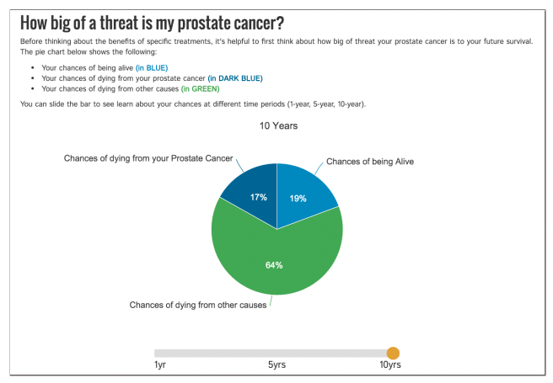
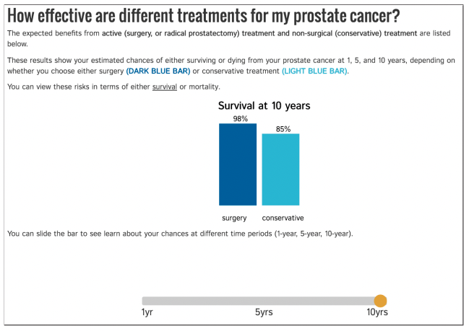
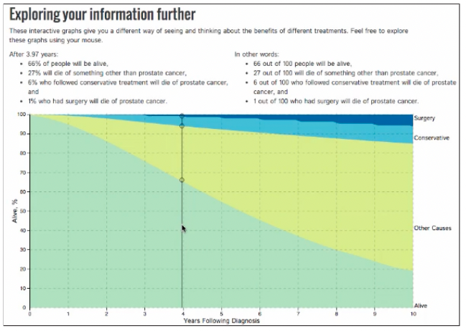
Evaluation Methods
Human Subject Experiments
Observational Study
Usability Studies
→ Observational study specifically focused on usability of a visualization
→ Range from low to high fidelity testing
High Fidelity
→ Working prototype
https://ieeexplore.ieee.org/stamp/stamp.jsp?arnumber=7539638
Notes:
Another type of observational study I want to touch on today is usability studies.
These are observational studies geared strictly towards evaluating a usability of a tool.
These types of studies can be formal observational studies that follow the structure I just explained, but with tasks and analyses the focus specifically on usability (for example checking narrations for recurring cases of participants being unable to find a particular button, or confused by some interactive functionality).
Or they can be something called low-fidelity tests. Low fidelity tests are used to test usability of a tool during the early design phases, as opposed to after the tool has been built in it’s entirely.
Often this is done with low-fidelity prototypes that are either made of paper (as shown here), or with wireframes which I’ll show you an example of in a moment.
In either case the set up of these studies consist of having participants perform a specific repeated task and narrating their completion of said task using a prototype of the final tool.
This can help illuminate usability issues before going through the trouble of building the entire tool. For example, these kinds of test can illuminate is a particular button is not in an intuitive spot, or if users don’t know where they should look to find some functionality, etc.

Slide 30
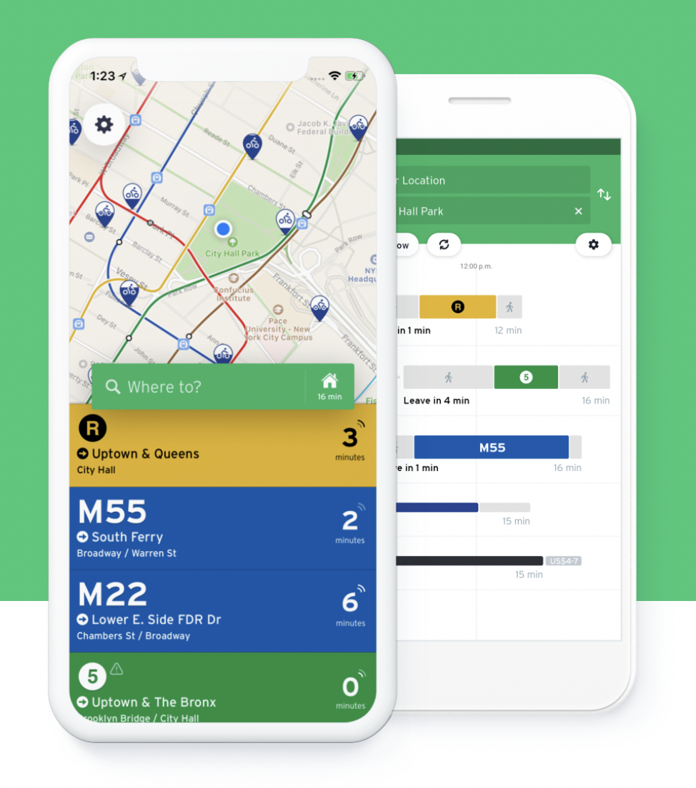
Evaluation Methods
Human Subject Experiments
Field Deployment or Case Studies
→ Deploy tool in realistic settings
→ Document effects on work practices
→ Observe usage in the “real world”
→ Collect qualitative or quantitative data (ex. satisfaction, number of times used in a week, etc.)
Validation
https://transitapp.com/
Notes:
The final type of human subject experiment we’ll talk about today are field deployment or case studies.
For this type of experiment, a tool is deployed in a realistic setting and it’s usage and effects are observed.
As we saw earlier, this type of testing is best suited to evaluating if you understood the domain problem you were trying to solve with your visualization.
For example, pretend you created an app for the MBTA that tracked but and train arrivals and departure from stations. One way to test if that app was effective for bus and train riders would be to deploy it amongst a group of beta testers and see if those testers changed their riding behavior, based on the app.

Slide 31
Evaluation Design
1) Goal
→ Munzner’s nested model
2) Method
→ Select an evaluation technique
3) Who
→ Who are your participants (and how many)
4) Tasks
→ What will the participant do
5) Metrics
→ Decide what data to collect
6) Analysis
→ How will you analyze collected data
Validation
Notes:
I like to break up the design of evaluations into 6 major steps.
<read>

Slide 32
Evaluation Design
1) Goal
→ Munzner’s nested model
2) Method
→ Select an evaluation technique
3) Who
→ Who are your participants (and how many)
4) Tasks
→ What will the participant do
5) Metrics
→ Decide what data to collect
6) Analysis
→ How will you analyze collected data
Validation
Notes:
I like to break up the design of evaluations into 6 major steps.
<read>

Slide 33
Data Collection
Tasks and Metrics depend on goal
Common metric choices include:
- Speed
- Accuracy
- Quality of finding
- Satisfaction
- Recall/Memorability
- Requiring help
- Completeness and Thoroughness of Analysis
- False Positives and False Negatives
- Immersiveness
- Deviation from optimality
- Information accessed
- Use frequency
→ How often do users use this tool?
- Effort / Ease of Use
→ Cognitive
→ Physical (how many clicks did it take)
→ NASA-TLX
Notes:
The task and metrics you select for an evaluation depend largely on your goal.
For example, when we talked about controlled experiment and I went through my example of testing a new visualization tool for outlier detection, you hopefully noticed that the task I chose (identify outliers) was directly related to my goal of comparing outlier detection with my tool to outlier detection with existing tools.
As another example, think back to when we talked about usability studies. In those evaluations our goal is to test usability, and as a result we select tasks that require participants to use or navigate through different features of the tool we are testing.
Similarly, we collect data with respect to our evaluation goal. For the outlier detection experiment, I said I’d collect time and accuracy, these are common metrics used to assess performance, which was my goal with the experiment.
For the usability study, I said I’d collect think out loud data (ie narration of users), and analyze that for common points of confusion or usability problems, which tracks with my goal for the experiment.
On this slide I’ve listed some common metrics that are collected in experiments with respect to different goals.
Let’s look at a few examples of metrics used in evaluations.

Slide 34
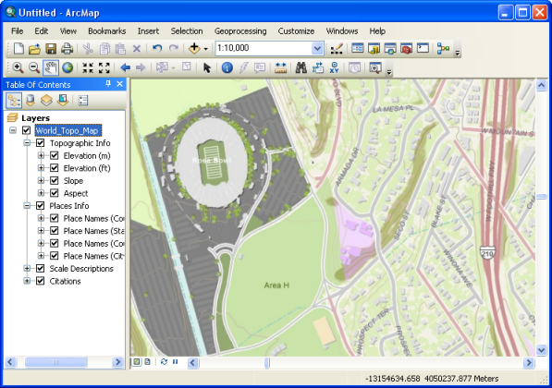
ArcGIS vs. Google Maps – Which results in better spatial understanding of an area?
Data Collection
Researchers compared speed and accuracy and found no difference
But now we know users in Google Maps tend to interact a lot more
As a result, they don’t perform faster or better, but they have a better spatial understanding of the space
What other data could the researchers have collected?
Notes:
Let’s start by looking at an experiment where researchers compared Google Maps to ArcGIS.
For their controlled experiment, these researchers compared speed and accuracy on a task given the two tools.
They found no difference between these metrics, but it is well known that Google Maps tends to result in better spatial understanding of an area than ArcGIS.
Any thoughts on how this experiment could have been designed differently to better compare Google Maps and ArcGIS?

Slide 35
Data Collection
Insight Based Evaluation (a type of observational study)
Proposed by Chris North et al. in 2005
Method: determine the utility of a visualization system by the number of insights generated by the user
Evaluation:
Tally number of insights (distinct observations about the data by a participant)
Various quantitative statistics collected on insight generation (time spent, time to first insight, etc.)
Notes:
The metric used for this type of study is number of insights generated, an often other quantitative statistics like time.

Slide 36
Insight Based Evaluation (a type of observational study)
Data Collection
Method: determine utility based on number of insights generated
No specific tasks
Participants get training on data and visualization for 15 minutes
Participants list some analysis questions that they would like to pursue
Participants asked to examine the data for as long as necessary until no new insights can be gained
Participants asked to comment on their observations, inferences, and conclusions
Best for evaluating how well a visualization supports exploratory data analysis
Notes:
Another example is a specific type of observational study called insight based evaluation.
<read setup>

Slide 37

Data Collection
What metrics would you collect?
What metrics would you collect?
Scenario 1: We recently released a new interface for our visual analytics system. Can you help determine if our customers like the new design?
Scenario 2: My company currently uses Tableau to compare sales of different items over time, but we’ve recently heard about Looker and we’re wondering if it might be a better choice. Can you help determine if we should we switch?
Notes:
I think the best way to understand the relationship between goals, tasks, and metrics is to try relating the them for yourself.
So now, I want everyone to take a few minutes to think through the two scenarios on this slide.
For each of these, if you were to design an evaluation, what would the overall goal of that evaluation be and what tasks and metrics would you use to perform the evaluation?
<discuss>
Now, let’s look at some good and poor examples.

Slide 38
Let’s take a break! Stretch, go for a walk, be social ☺ Be back here in 10 mins.

Slide 39
Summary
Today we:
Reviewed evaluation and validation
ic-14 is DUE today.
pm-04 is OUT today and DUE Wed.

